Slide 1
Annotate Bibliographies
Personal Project

Slide 2
Definitions
Bibliography – a list of sources (books, journals, websites, periodicals, etc.) one has used for researching a topic. Bibliographies are sometimes called “References” or “Works Cited”.
It includes the bibliographic information
Author
Title
Publisher, etc.

Slide 3
Definitions
Annotation – a summary and/or evaluation.
Therefore, an annotated bibliography includes a summary and/or evaluation of each of the sources listed in you Bibliography.

Slide 4
What do you have to do?
Summarize –
What are the main arguments?
What is the point of this book or article?
What topics are covered?
If someone asked what this article/book is about, what would you say?
The Length of your annotations will determine how detailed your summary is.
https://owl.english.purdue.edu/owl/resource/563/02/

Slide 5
What do you have to do?
Assess – After summarizing a source, you should evaluate it.
Is it a useful source?
How does it compare with other sources in your bibliography?
Is this information Reliable?
Is this source biased or objective?
What is the goal of this source?
https://owl.english.purdue.edu/owl/resource/553/03/

Slide 6
What do you have to do?
Reflect – Once you have summarized and assessed a source, you need to ask how it fits into your research.
Was this source helpful to you?
How does it help you shape your argument?
How can you use this source in your research project?
Has it changed how you think about your topic?

Slide 7
Why write an annotated bibliography?
To Learn about your topic.
Writing an annotated bibliography is excellent preparation for a research project. Just collecting sources for a bibliography is useful, but when you have to write annotations for each source, you’re forced to read each source more carefully.
You begin to read my critically, instead of just collecting information.
Helps you gain a good perspective on what is being said about your topic.

Slide 8
Why write an annotated bibliography?
To Help Other Researchers
Extensive and scholarly annotated bibliographies are sometimes published. They provide a comprehensive overview of everything important that has been and is being said about that topic. You may not ever get your annotated bibliography published, but as a researcher, you might want to look for one that has been published about your topic.

Slide 9
Format
We Use MLA Formatting.
Type your annotated bibliography on standard, white paper
Double space the text of the paper, and use a legible font (Times New Roman), size 12 ONLY.
Leave one space after periods or other punctuation marks.
Margins are 1 in on all sides.
Indent the 1st line of paragraphs. (Use the tab key or press the space bar 5 times)
Create a “header” that numbers all pages consecutively in the upper right-hand corner. Your header should include your last name and then the page number.

Slide 10
The First Page…
Do NOT make a title page for your annotate bibliography.
In the upper left-hand corner of the first page, list your name, your instructor’s name, the course, and the date. (Be sure to use double spaced text)
Double space again and enter the title. Do NOT underline, italicize, or place your title in quotations; write the title in Title Case, not in all capital letters.

Slide 11
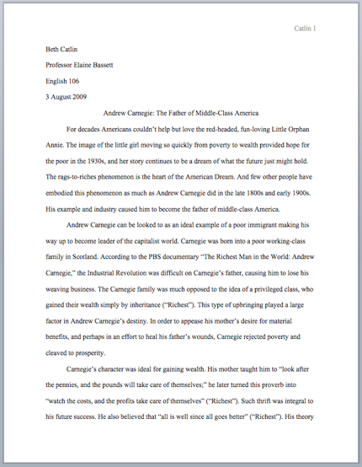
Example

Slide 12
Formatting – The Annotations
The Annotations for each source are written in paragraph form.
The length of the annotations can vary significantly from a paragraph to a couple of pages!

Slide 13
Example of an Annotated Bibliography
Look at the example in front of you.
What do you notice about the citation?
What do you notice about the annotation?

