Slide 1
Maus
By: Art Spiegelman

Slide 2
A little History
Comic Strip is the Grandfather of the Graphic Novel
They have been around since the end of the 1800’s.
Originally used to draw people to the Sunday Paper…. “Read the Funnies”

Slide 3
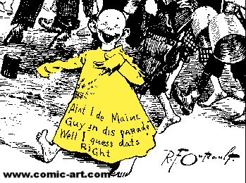
First Comic Strip
Appeared in New
York World in 1895
- R.F. Outcault
- Increased Sales
- Eventually endorsed
Soap-whiskey.

Slide 4
Katzenjammer Kids
1897
Used Word Balloons
Used Multiple Panels to tell
A story.

Slide 5
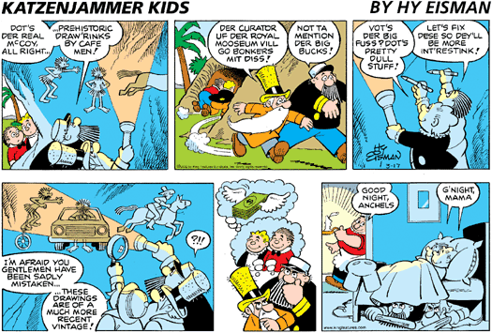

Slide 6
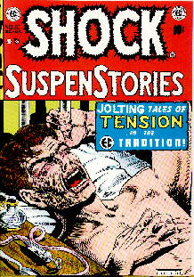
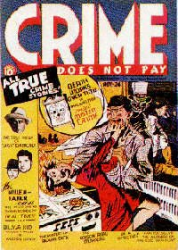
Popular Comics
Superman
First superhero
On Newstands in 1938
Superheroes were BIG during WWII
After WWII
Crime
Science Fiction
Horror

Slide 7
Milestones in the Graphic Novel World
1978 Will Eisner coins the term “Graphic Novel”
1986 Batman the Dark Knight Returns
1987 The Watchman

Slide 8
1992 Maus: A Survivor’s Tale wins
Pulitzer Prize.
20015 – “Graphix” imprint launched
2006 – American Born Chinese named NBA finalist for Young People’s Literature
2007 – YALSA creates new annual book
List: “Great Graphic Novels for Teens”
2009 NYT Graphic Books Bestseller List

Slide 9
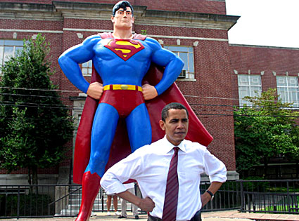
Fun Facts
President Obama
collects both
Spider-Man and
Conan the Barbarian comics

Slide 10
Graphic Novel
Graphic novels can be fiction, non-fiction, history, fantasy, or anything in-between.
They are similar to comic books because they use sequential art to tell a story.
UNLIKE comic books, graphic novels are generally stand-alone stories with more complex plots.

Slide 11
Types of Graphic Novels
There are endless ways to categorize graphic novels.
There are as many genres and sub-genres as in traditional fiction and non-fiction. The following are a few of the major…
Manga
Superhero Story
Perzines – Personal Narratives
Non-Fiction

Slide 12
Manga
The Japanese word for “comic” but in the US is used to descript Japanese style comics.
Manga is read from top to bottom and right to left as this is the traditional Japanese reading pattern.
Technically, Manga refers to Japanese comics, many think Manga refers to a style rather the the country of origin.
Examples:
Death Note, Full Metal Alchemist

Slide 13
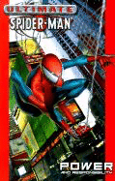
Superhero Story
Superhero graphic novels have taken the most popular form of comics and turned what were once brief episodic adventures into epic sagas.
Superhero comics are dominated by a few mainstream publishers
Examples
Batman: Dark Knight Returns
League of Extraordinary Gentleman
Astrocity

Slide 14
Perzines – Personal Narratives
These are autobiographical stories written from the author’s personal experiences, opinions, and observations.
Examples
Fun Home
Blankets
Lucky
The Quitter

Slide 15
Non-Fiction
Are similar to Perzine’s in that they are written from the author’s personal experience, but the author is generally using their own experience to touch upon a greater social issue.
Example
Pedro and Me
Persepolis

Slide 16
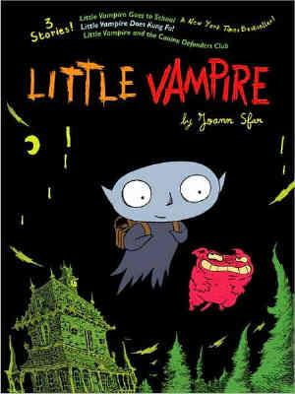
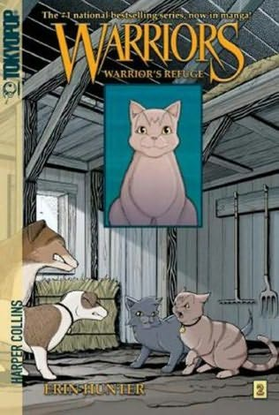
Important things to Note…
Same format as comic books
Text and illustrations present information
Book-length, usually contain one story
Medium, not a genre

Slide 17
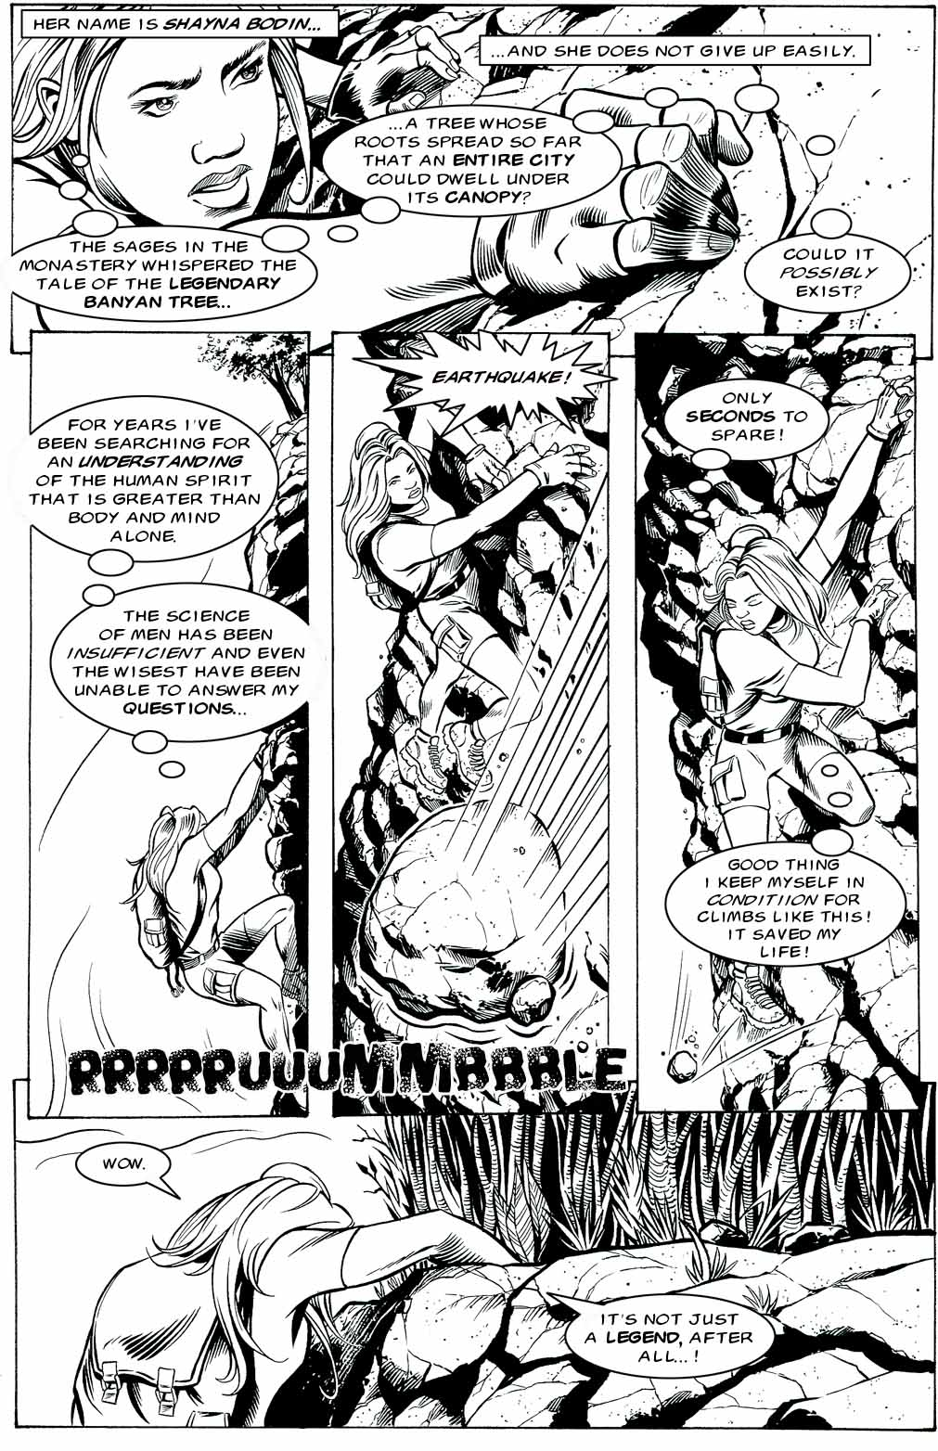
How do they work…
Caption
Panel
Thought Balloon
Gutter
Sound Effect
Dialog Balloon

Slide 18
Context Clues
Take the next 5 minutes and using the previous slide, determine what the meaning of each of the highlighted vocabulary words means…
Caption
Thought Balloon
Sound Effect
Dialogue Balloon
Panel
Gutter
At the end of 5 minutes, you will discuss with a partner the definition that you have come up with. Together you will formulate and share your definitions.

Slide 19
Dialogue Balloons Vs. Captions
Take a minute and brainstorm the difference between a dialogue balloon and a caption…

Slide 20
Difference
Diaglogue Balloons allow words (and much less often, pictures) to be understood as representing the speech or thoughts of a given character in the comic.
A Caption is a brief explanation appended to an article.

Slide 21
What is a Panel?
A comic book is made up of individual panels, a visual or implied boundary that, when put together, tell a story in a sequential order.
A good way to look at a panel is that it is like a scene in a movie or television show. The comic panel would be the most important part of the scene to convey the most information visually.
The dialogue balloons are used to complete the tale!

Slide 22
What is a Gutter?
the space between the panels. reader moves from one panel to the next and comes to a conclusion about whats happening.

Slide 23
Class work
You will create a 4 panel comic strip. These can be arranged anyway that you like. You must include,
Dialogue Balloon
Gutter
Sound Effects
Thought Balloon
And a caption
Your comic strips will be due on Friday March 14, 2014

